Slide 1
MATRIX CALCULATOR
JAVA MINI PROJECT

Slide 2
Contents
Architecture Diagram
UML Diagrams
Platform
Result
Test cases and Conclusion

Slide 3
Architecture Diagram

Slide 4
Matrix A
Matrix C
Matrix B
B*A
Transpose of A
A+B
A*B
Inverse of A
Determinant of B
Adjoint of A
Determinant of A
Inverse of B

Slide 5
UML DIAGRAMS

Slide 6
Sequence Diagram

Slide 7

USER
APPLICATION
MATRIX C
1. Open Application
A+B (If Matrices A & B have equal no. of rows)
2. Enter Matrices A & B
A*B (If Matrix A columns are equal to Matrix B rows)
B*A (If Matrix B columns are equal to Matrix A rows)
Adjoint of Matrix A
Same values are used
Inverse of Matrix A & B if The matrices are square Matrix i.e. Rows are equal to column
Determinant of Matrices A & B
Transpose of Matrix A

Slide 8
Activity Diagram

Slide 9
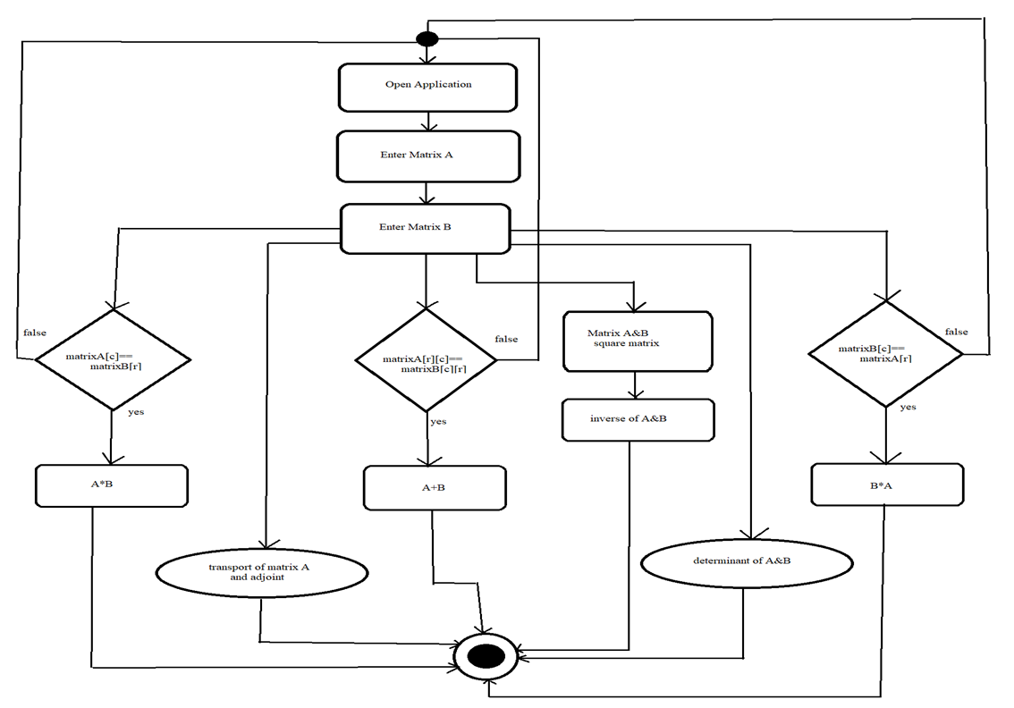

Slide 10
Platform Used
Insert the title of your subtitle Here
JavaFx
Java development Kit
It is a software platform for creating and delivering desktop applications, as well as rich web applications that can run across a wide variety of devices.
The JDK is a development environment for building applications , applets, and components using the Java programming language.
Command Prompt
cmd.exe is the default command-line interpreter for the Microsoft Windows. It is used to compile and run the java project.
Notepad
Windows Notepad is a simple text editor for Microsoft Windows and a basic text-editing program which enables computer users to create documents.

Slide 11
Result

Slide 12
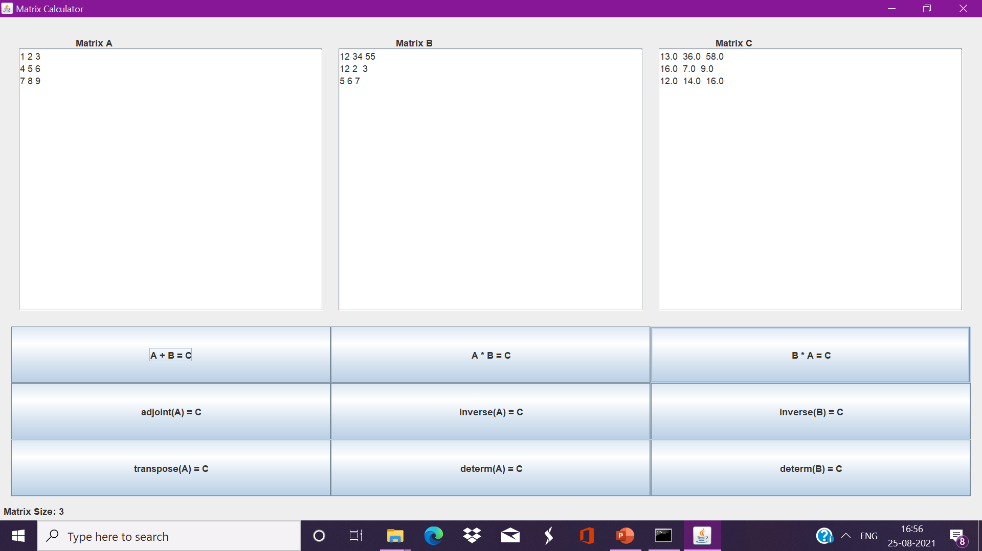
Matrix Calculator works as follows:
When the matrices A and B are square matrix it performs addition and shows the result in matrix C.

Slide 13
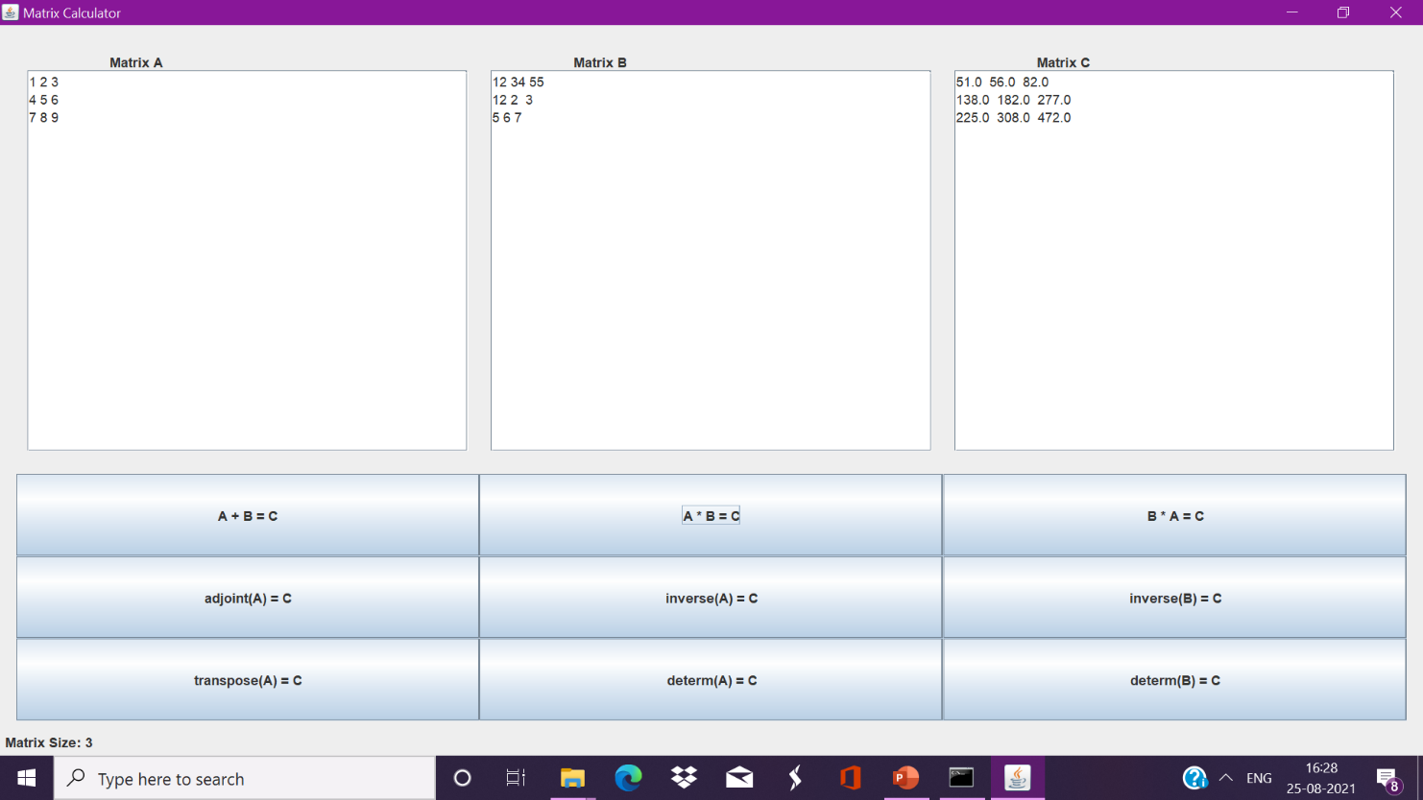
When the number of columns in the first matrix to be multiplied is equal to the number of rows of the second matrix then we proceed for multiplication with the result on matrix C.

Slide 14
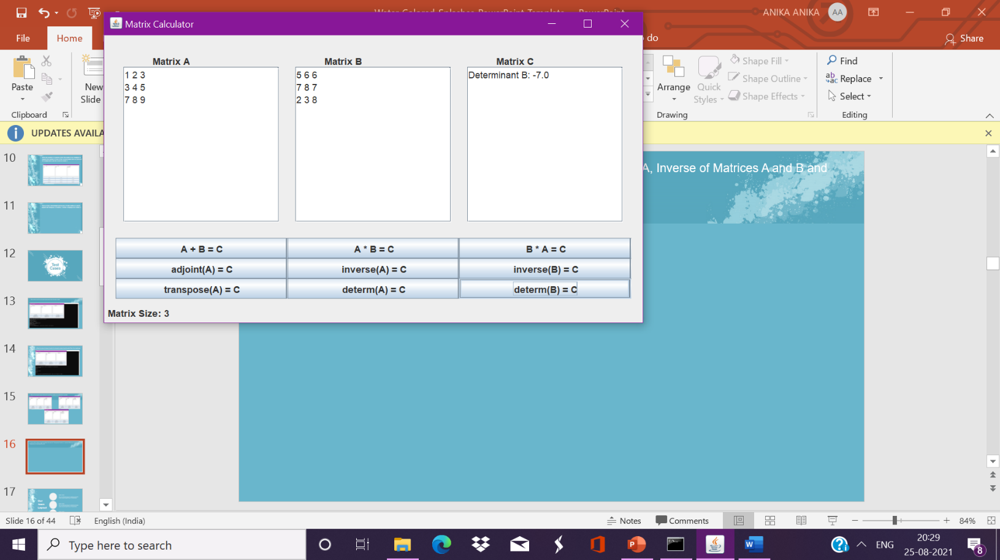
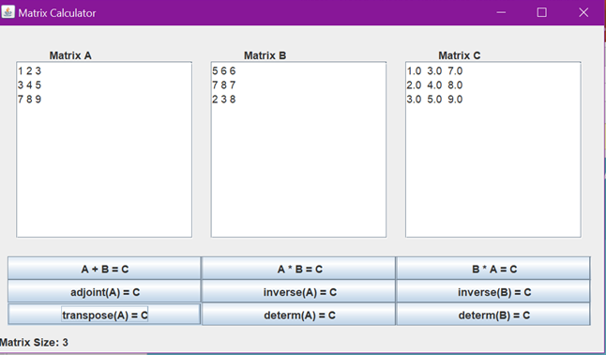

Then we have determinant for both matrices A and B,Adjoint and transpose of matrix and also inverse of Matrices A and B for which we need a square matrix. All this is displayed on matrix C.

Slide 15
Test
Cases

Slide 16
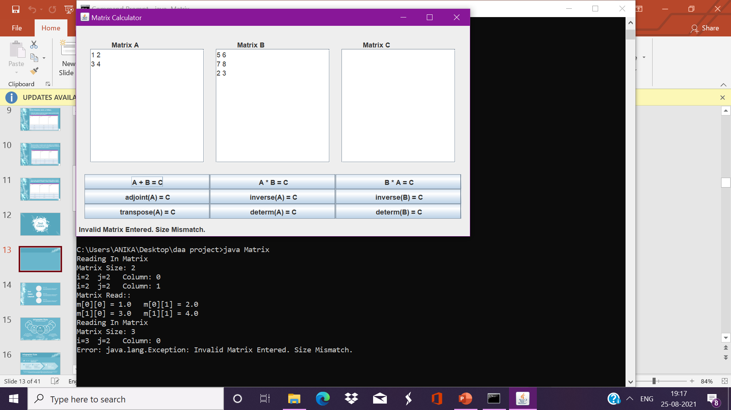
When matrix A and B are not equal square matrix then the case is invalid.

Slide 17
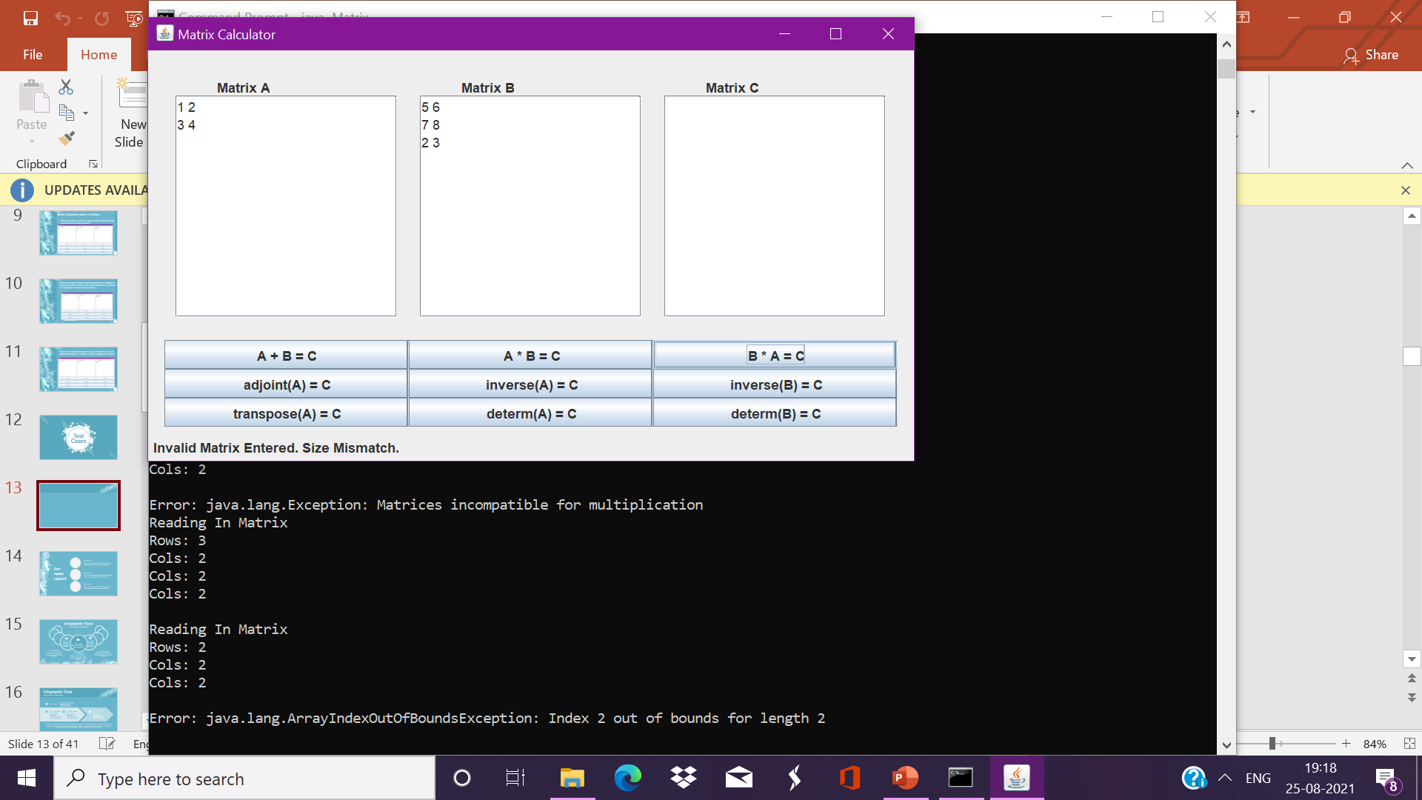
When the number of columns for matrix A is not equal to number of rows for matrix B then it’s an invalid case.

Slide 18
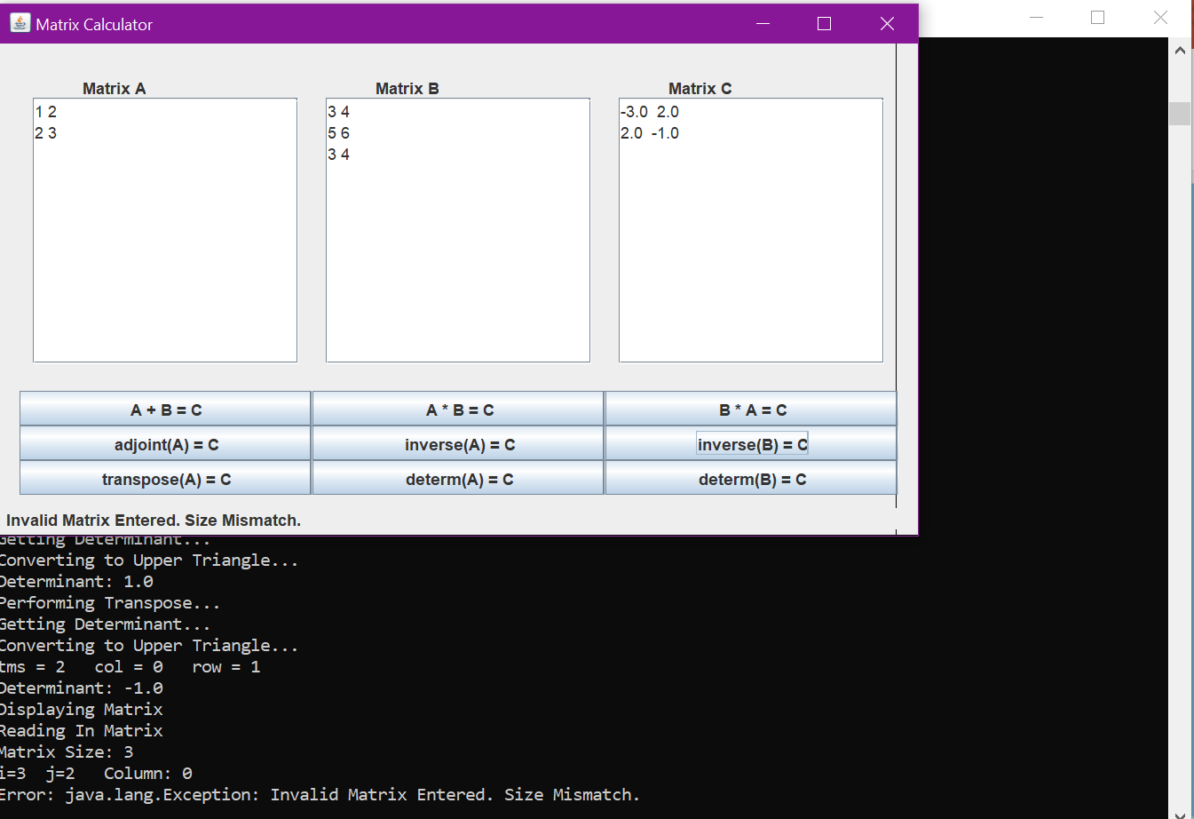
Inverse of Matrices are not possible we don’t have a Square Matrix.

Slide 19
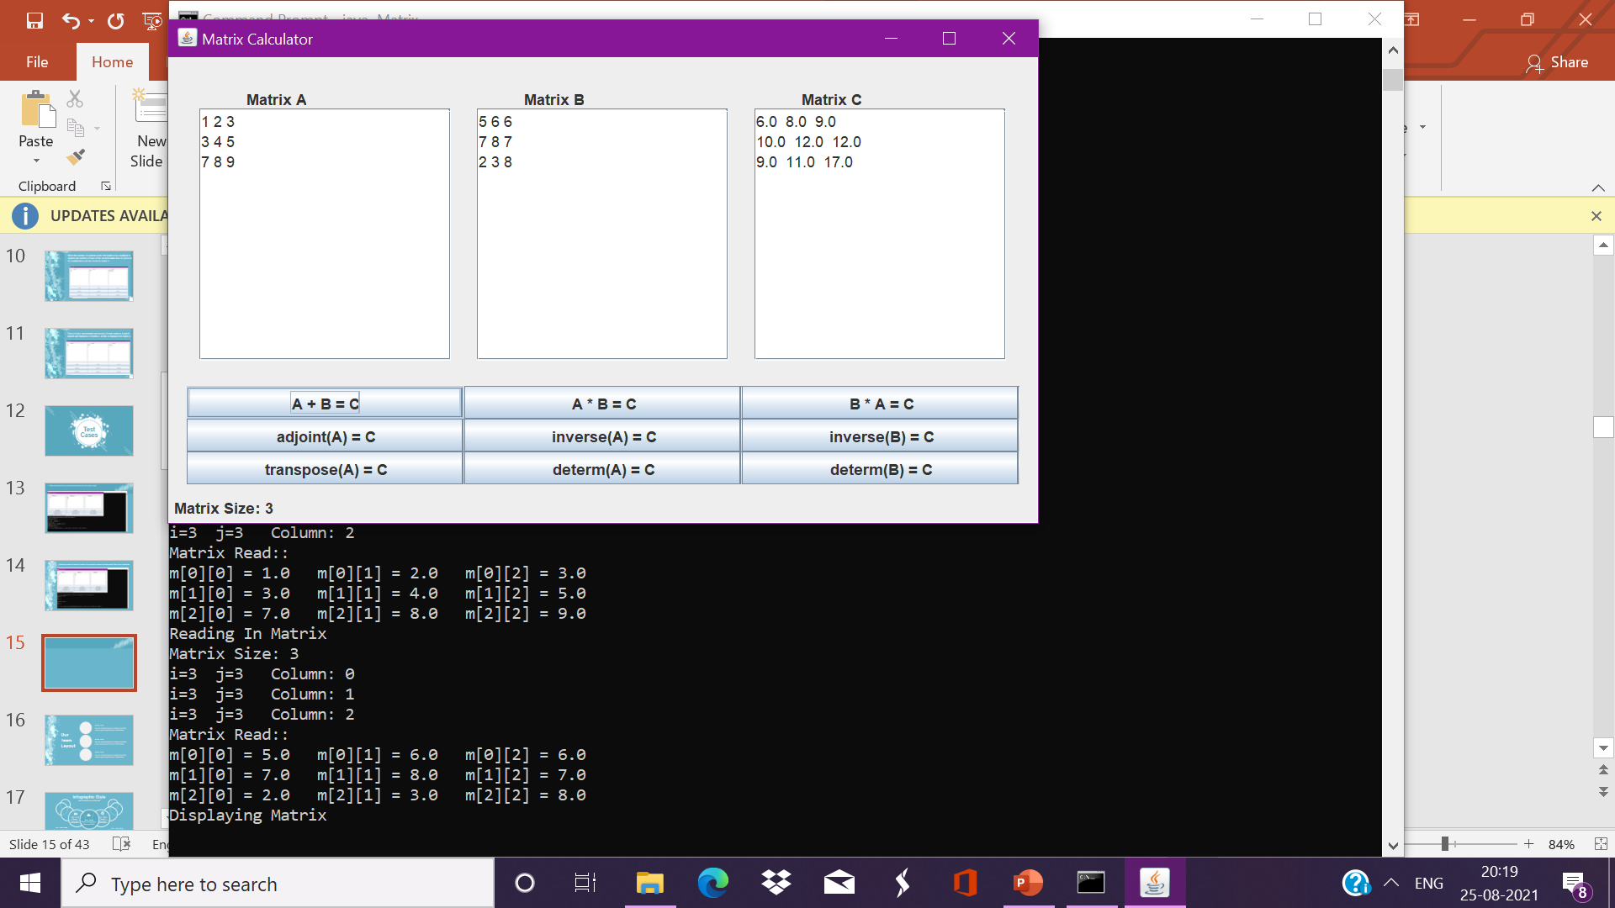
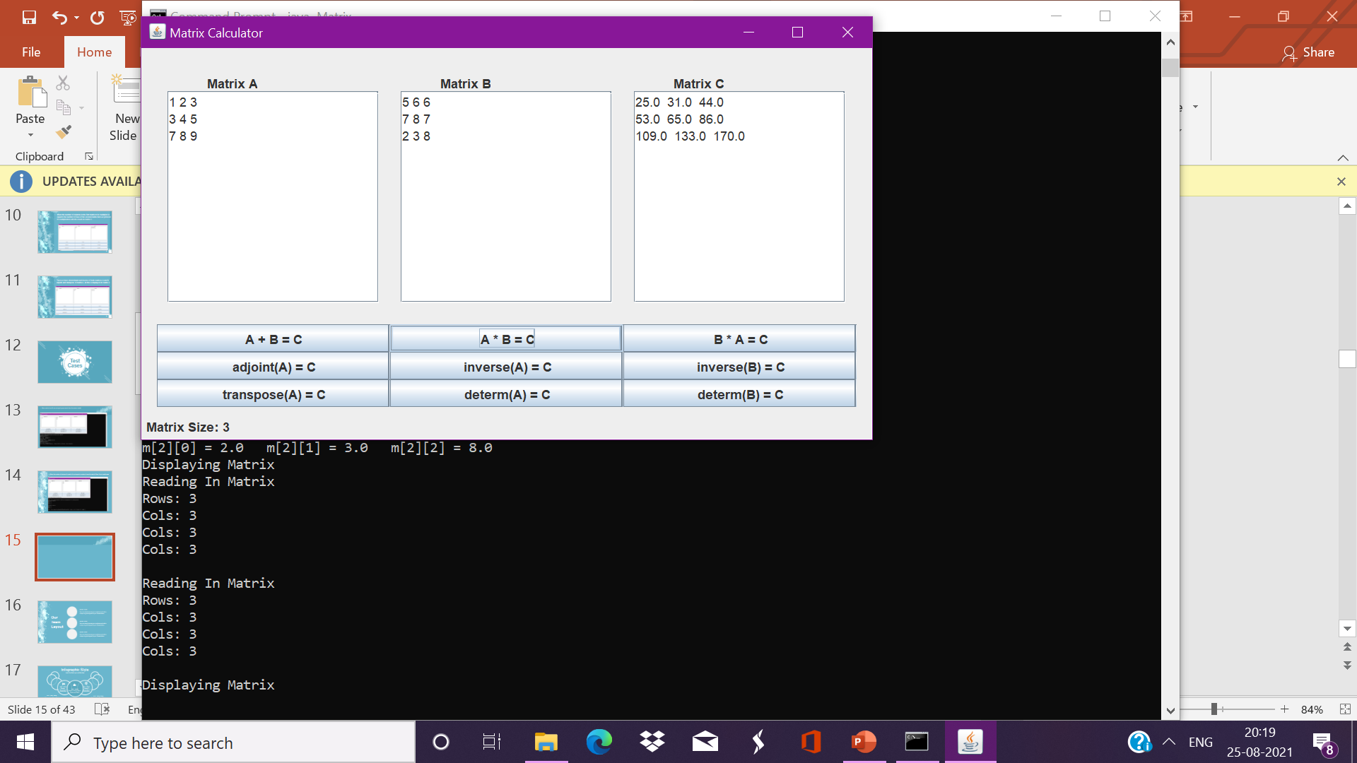

When we have equal square matrices for A and B then addition and multiplication is possible.

Slide 20
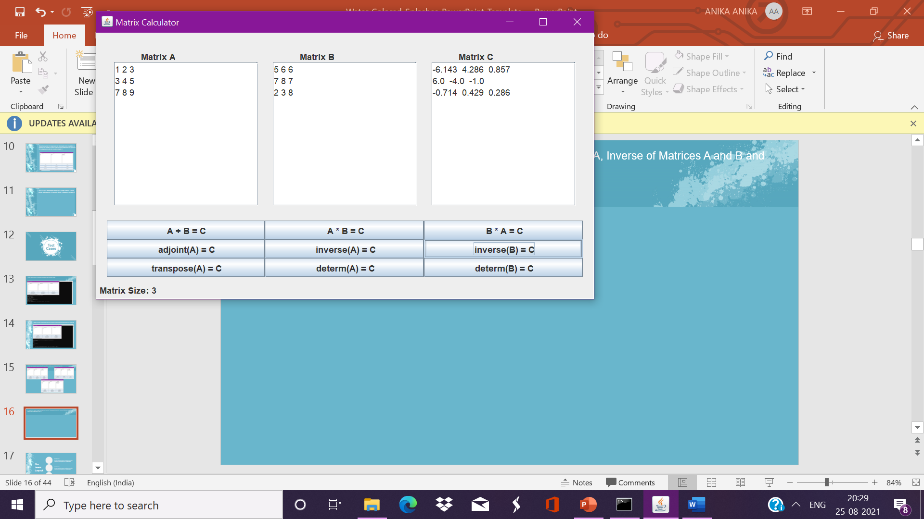

Other than that we have the Adjoint of matrix A, Transpose of matrix A, Inverse of Matrices A and B and Determinant of matrices A and B.
Inverse of Matrix B
Determinant of Matrix B

Slide 21
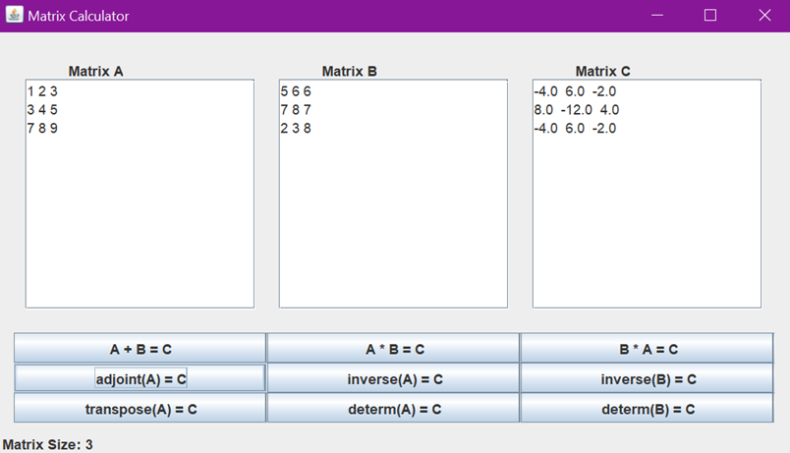
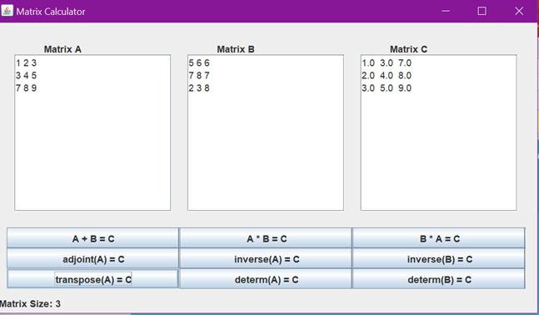
Adjoint of Matrix A
Transpose of Matrix A

Slide 22

We would like to conclude this presentation by saying that matrices are useful in many ways. For example, transformation matrices are commonly used in computer graphics and image processing as well as computer generated images that have a reflection and disorientation effect what we presented was only a small fish in a big ocean called matrices. We showed how much can be done using matrices but there can me many additions in the future.
Conclusion

Slide 23
Thank you
By Anika & Archana V. Bhat

